Slide 1



KONGU ENGINEERING COLLEGE
PERUNDURAI ERODE-638060
MSC-SOFTWARE SYSTEMS
22ISL23-WEB PROGRAMMING
MINI PROJECT
AUTOMOBILE
Team Members:
K.J.ANANDHA KUMAR
(22ISR002)
K.P.DEEPAN
(22ISR009)

Slide 2


Automobile
In this web page user can learn some information about the cars.
The user can book a car for a test drive for small distances.
In our webpage some vehicle images are upload to know the details
Use Images / Photos / Video | Don’t just answer given points in slides | Avoid para | Use bullet points

Slide 3
Specification
In this webpage we create a form to book a car for test drive.
And here we clearly described about model and the properties of the vehicle.
If you book a car for test drive our employees bring the car to your location and you can test drive it.
Use Images / Photos / Video | Don’t just answer given points in slides | Avoid para | Use bullet points

Slide 4






Slide 5

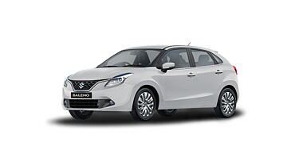
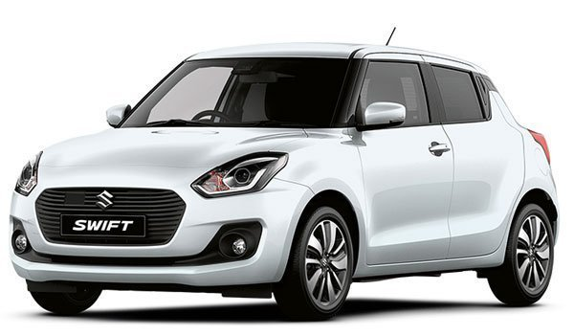
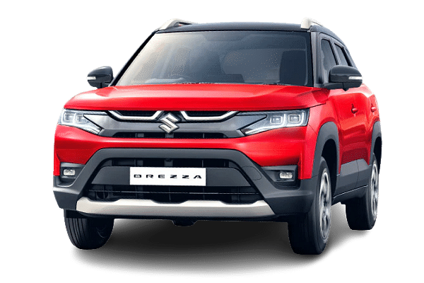

Slide 6

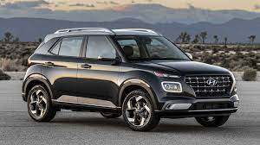
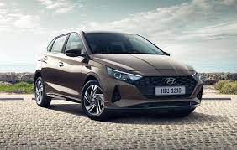
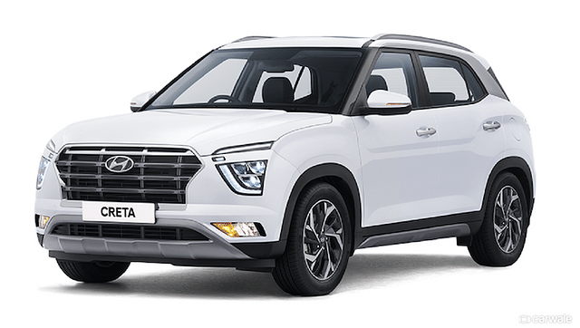
l

Slide 7
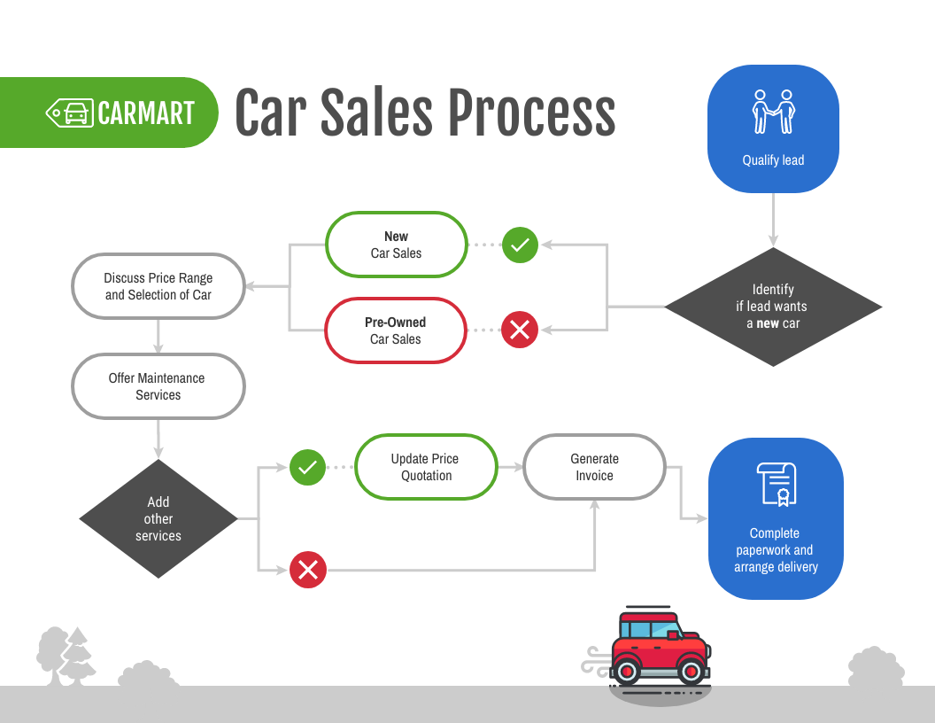
Flowchart / Product workflow

Slide 8
Competitors
So there are many companies to provide test drive and they sell car but they have only one brand like Hyundai,Honda.
We have all models of vehicles in one place.

Slide 9
Future Plan
Now we focus on 3 brands
In future we focus on all car brands
………..
Use Images / Photos / Video | Don’t just answer given points in slides | Avoid para | Use bullet points

Slide 10
Thank You !!

Slide 11
Reference Slides

Slide 12
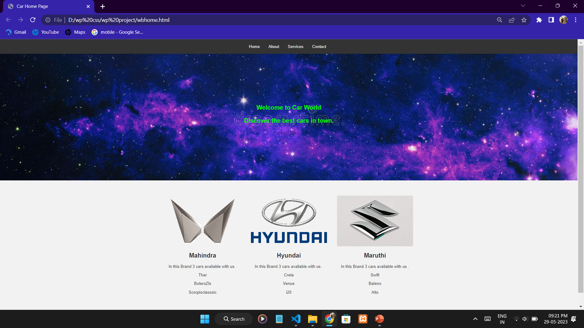



Slide 13
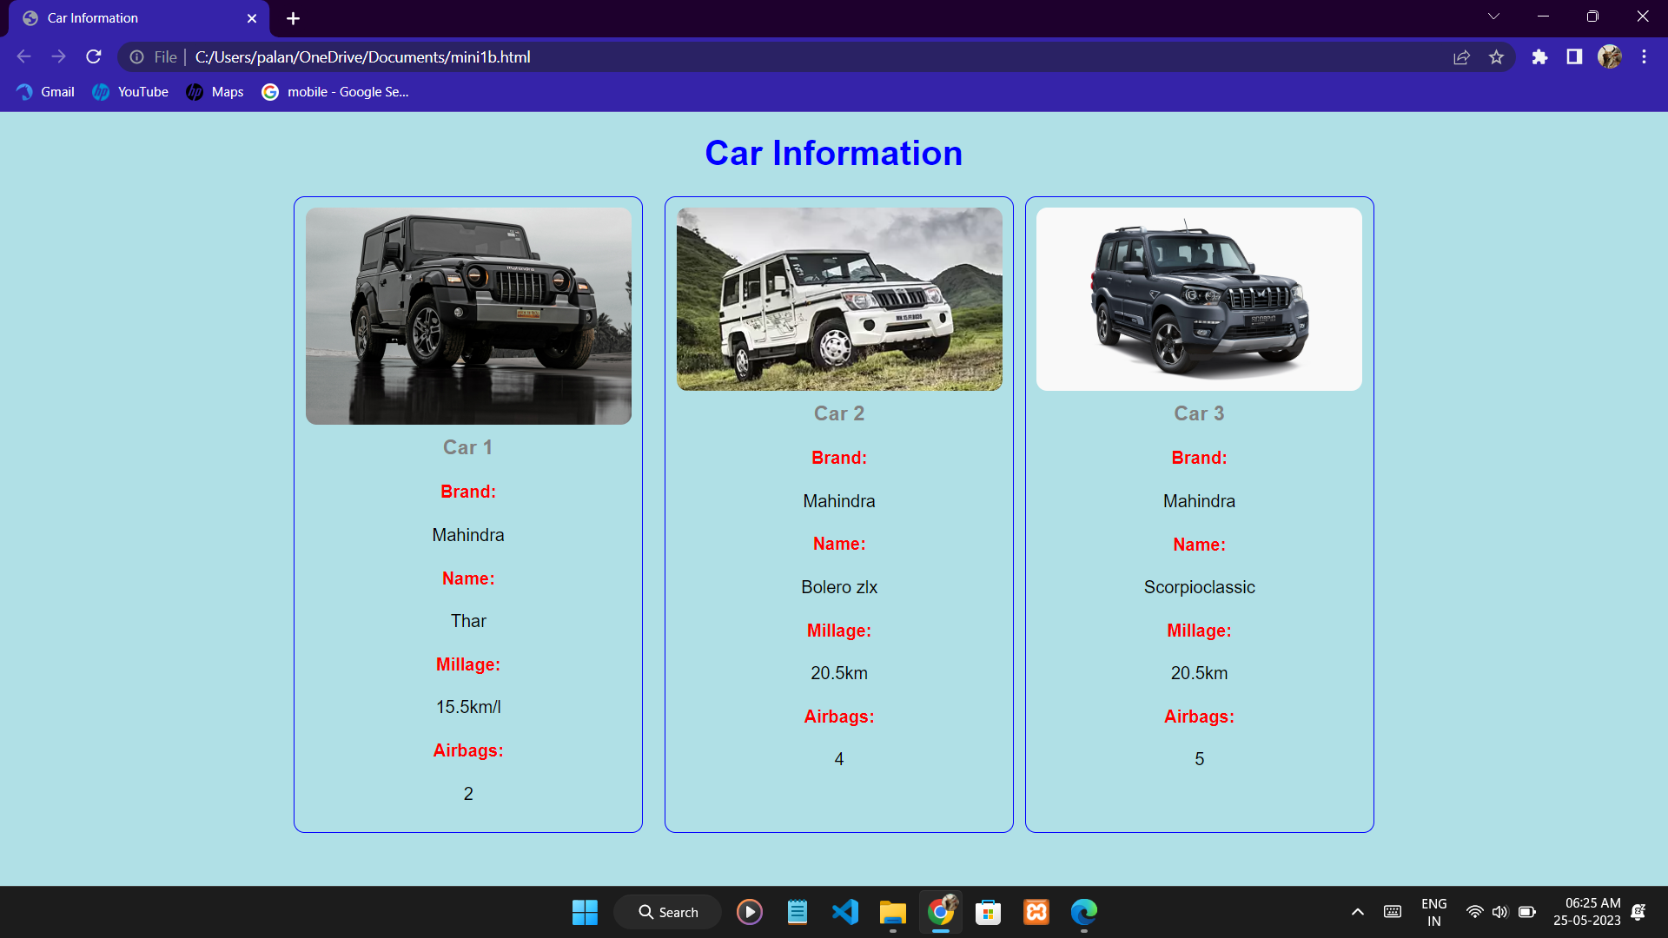

Slide 14
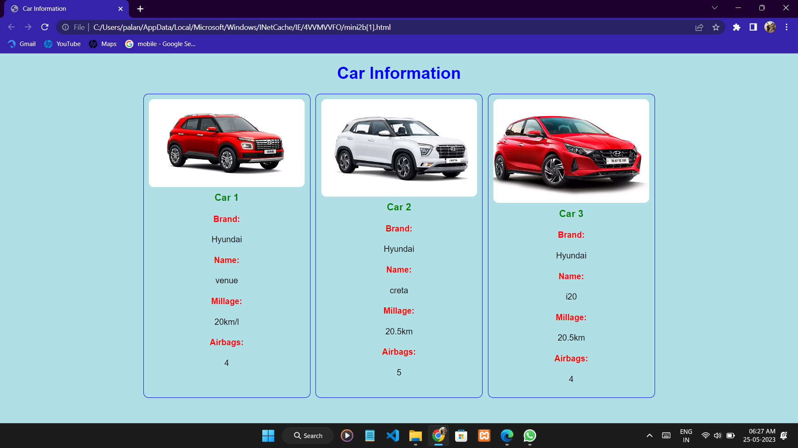

Slide 15
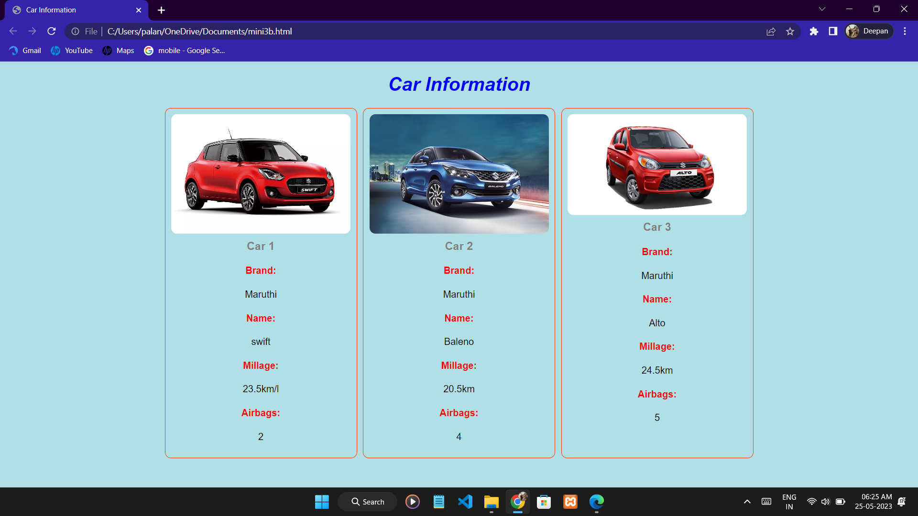

Slide 16
